Slide 1




LENDI INSTITUTE OF ENGINEERING AND TECHNOLOGY
(Autonomous)
Approved by AICTE and Permanently affiliated to JNTU Gurajada-Vizianagaram.
ECE,EEE,CSE&MECH
DEPARTMENT OF COMPUTER SCIENCE AND ENGINEERING
NAME OF THE SUBJECT :Distributed Systems
NAME OF THE TOPIC : Introduction to Distributed Systems
PRESENTED BY :
Mr. Satish Dekka
Associate Professor

Slide 2
Contents:
    Introduction
    Characterization of Distributed Systems
    Examples of Distributed Systems
    Resource Sharing and the Web Challenges.
    System Models and Introduction
    Architectural Models
    Software Layers
    System Architecture
    Variations
    Interface and Objects
    Design Requirements for Distributed Architectures Fundamental Models
    Interaction Model
    Failure Model
    Security Model.

Slide 3
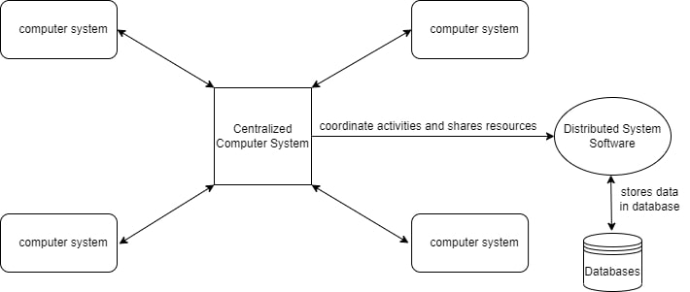
Introduction:
A distributed system is a collection of computer programs that utilize computational resources across multiple, separate computation nodes to achieve a common, shared goal.
Distributed System is a collection of autonomous computer systems that are physically separated but are connected by a centralized computer network that is equipped with distributed system software. The autonomous computers will communicate among each system by sharing resources and files and performing the tasks assigned to them.

Slide 4
Characteristics of Distributed System:
Resource Sharing: It is the ability to use any Hardware, Software, or Data anywhere in the System.
Openness: It is concerned with Extensions and improvements in the system (i.e., How openly the software is developed and shared with others)
Concurrency: It is naturally present in Distributed Systems, that deal with the same activity or functionality that can be performed by separate users who are in remote locations. Every local system has its independent Operating Systems and Resources.
Scalability: It increases the scale of the system as a number of processors communicate with more users by accommodating to improve the responsiveness of the system.
Fault tolerance: It cares about the reliability of the system if there is a failure in Hardware or Software, the system continues to operate properly without degrading the performance the system.
Transparency: It hides the complexity of the Distributed Systems to the Users and Application programs as there should be privacy in every system.
Heterogeneity: Networks, computer hardware, operating systems, programming languages, and developer implementations can all vary and differ among dispersed system components.

Slide 5
Advantages of Distributed System:
Applications in Distributed Systems are Inherently Distributed Applications.
Information in Distributed Systems is shared among geographically distributed users.
Resource Sharing (Autonomous systems can share resources from remote locations).
It has a better price performance ratio and flexibility.
It has shorter response time and higher throughput.
It has higher reliability and availability against component failure.
It has extensibility so that systems can be extended in more remote locations and also incremental growth.

Slide 6
Disadvantages of Distributed System:
Relevant Software for Distributed systems does not exist currently.
Security possess a problem due to easy access to data as the resources are shared to multiple systems.
Networking Saturation may cause a hurdle in data transfer i.e., if there is a lag in the network then the user will face a problem accessing data.
In comparison to a single user system, the database associated with distributed systems is much more complex and challenging to manage.
If every node in a distributed system tries to send data at once, the network may become overloaded.

Slide 7
Applications Area of Distributed System:
Finance and Commerce: Amazon, eBay, Online Banking, E-Commerce websites.
Information Society: Search Engines, Wikipedia, Social Networking, Cloud Computing.
Cloud Technologies: AWS, Salesforce, Microsoft Azure, SAP.
Entertainment: Online Gaming, Music, youtube.
Healthcare: Online patient records, Health Informatics.
Education: E-learning.
Transport and logistics: GPS, Google Maps.
Environment Management: Sensor technologies.

Slide 8
Examples of Distributed Systems
Networks
Telecommunication networks
Distributed Real-time Systems
Parallel Processing
Distributed artificial intelligence
Distributed Database Systems

Slide 9
2. Examples of Distributed Systems
Local Area Network and Intranet
Database Management System
Automatic Teller Machine Network
Internet/World-Wide Web
Mobile and Ubiquitous Computing
Notes:
We now review several systems that most of you have come across already (possibly without being aware that they are distributed).
This review will provide you with a better understanding of the issues that are to be tackled during distributed systems construction.

Slide 10
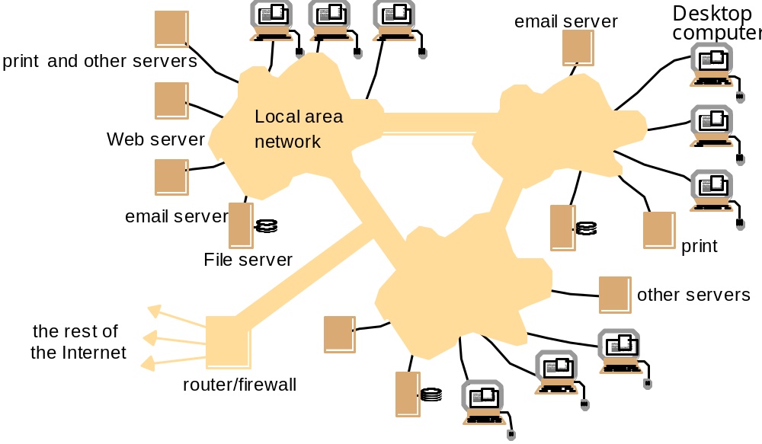
2.1 Local Area Network
Notes:
A local area network consists of a number of different computers. Workstations and Personal computers provide the front-end for network users. Different servers provide shared services.
One or several network file servers provide data storage services. Any workstation and PC may henceforth store files on disks maintained by these file servers.
A local name server maps machine names to IP addresses, user names to user ids and group names to group ids. Any machine can request a service to resolve a certain name.
One or several print servers control the access to shared printers.Workstations and PCs have the server printing jobs for them.
Another component provides a gateway to the wide area network.
As a user you need not be aware which machine provides which service.
Name servers provide the information regarding machine (by IP address), user names (by user ids), and group name (by group ids).
Local area networks can be connected together to form Intranets.

Slide 11
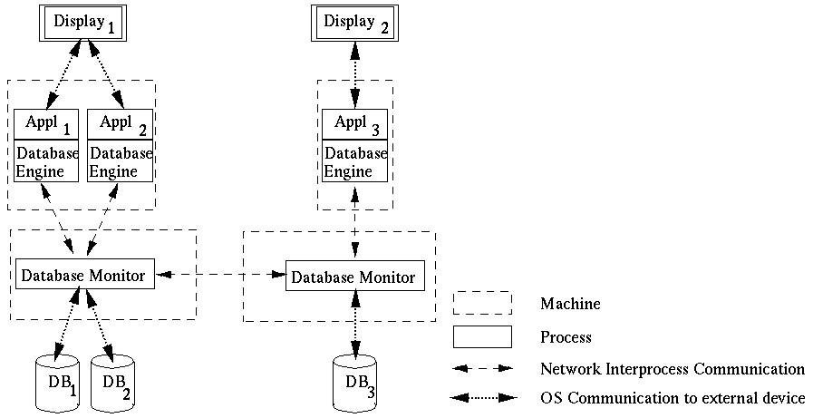
2.2 Database Management System
Notes:
Different client applications want to access and update shared data in a database.
Client applications might be banking systems, real-estate agencies, airline-ticket reservation systems accessing data like balances of bank accounts, details of property that are for sale or to let, or airfares and aircraft reservation data.
The database is physically distributed over several processors to take advantage of local data accesses for increased performance of client applications.
Data may be replicated to reduce the impact of failures of a processor and/or the network.
Each processor runs a database monitor that implements the mapping between the database seen by clients and the physical database stored on the different processors.
Database monitors have to cooperate with each other to implement client accesses to remote data, updates of replicated data and concurrency control.
The physical distribution of data is therefore transparent to clients.

Slide 12
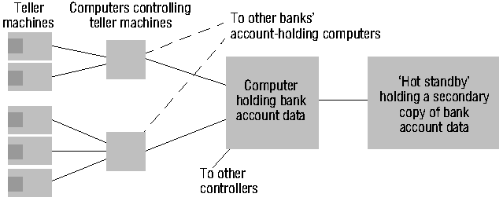
2.3 Automatic Teller Machine Network
Notes:
An automatic teller machine network enables bank customers to withdraw cash from their bank account.
Banks and building societies maintain large networks of teller machines.
Customer have high security, privacy and reliability requirements.
Customers may want to withdraw cash from their account through a ´foreign´ teller machine.
A front-end computer controls one or several tellers. It
transfers withdrawal requests to the computer of the account holder´s bank,
awaits the bank granting the request, and
therefore has to be interoperable with heterogeneous computer systems (Hang Seng Bank may have different account management systems than HongKong Bank and Bank of China).
Each bank has fault-tolerant systems to quickly recover from failures of their account holding computers. An example is the ´Hot standby´ computer which maintains a copy of the account database and can replace the main computer within seconds.

Slide 13
2.4 Internet
intranet
%
ISP
%
%
%
backbone
satellite link
desktop computer:
server:
network link:
Notes:
Internet is the largest distributed system in the world.

Slide 14
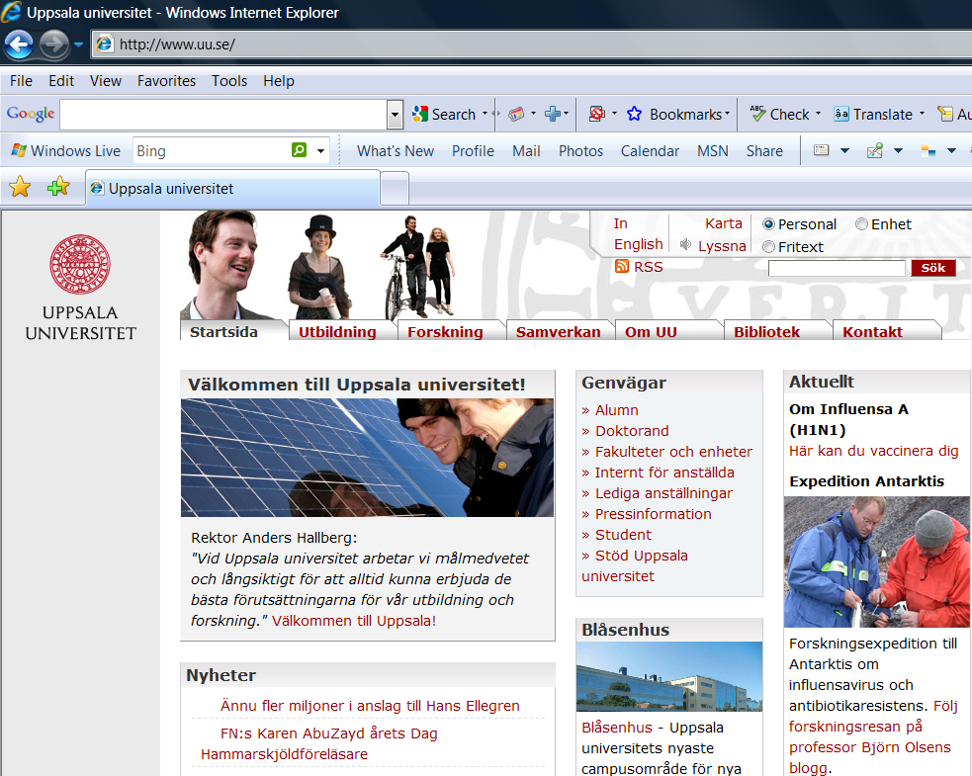
2.4.1 World-Wide-Web
Notes:
World Wide Web is the largest software application running on Internet. It becomes the most popular distributed software application ever created.

Slide 15
2.4.2 Web Servers and Web Browsers
http://www.google.comlsearch?q=lyu
www.google.com
Web servers
Browsers
www.uu.se
Internet
http://www.uu.se/
www.w3c.org
File system of
http://www.w3c.org/Protocols/Activity.html
www.w3c.org
Protocols
Activity.html
Notes:
A Web browser is a user interface to the world´s biggest distributed system, the Internet.
A Web page includes links to other Web pages. These links are specified as URLs.
An URL is the name of a protocol (ftp, http, etc.), the name of a site (gateway1.cse.cuhk.edu.hk) and the name of a file.
To follow a link to a remote Web page, your Web browser
talks to the local name server to resolve the symbolic site name into an IP address (137.189.89.153).
talks to the http daemon running on that web site and requests the delivery of the Web page addressed by the URL.
To obtain a file from a remote ftp site, your Web browser
resolves the site name with the local name server
talks to the ftp daemon running on that site and performs an anonymous login.
switches the daemon into an appropriate transfer mode and
obtains the file addressed by the file addressed in the URL.
To send an e-mail, your Web browser
opens a new dialog window where you can enter the addressee(s) and the e-mail text
talks to the local sendmail daemon to have it delivering the e-mail to the sendmail daemons on the sites of your addressees.

Slide 16
2.5 Mobile and Ubiquitous Computing
Internet
Host intranet
GSM/GPRS
Home intranet
Wireless LAN
gateway
Mobile
phone
Printer
Laptop
Camera
Host site
Notes:
Mobile and ubiquitous computer extend the access of Internet and distributed system architecture from wire-line connections to wireless connections.

Slide 17
Web Challenges in Distributed System
Scalability –The feature of distributed systems in which if the load of a system increases the performance of the system will not be degraded.
Heterogeneity - The ability to communication with different devices. For example, communication between computer to mobile or other peripheral devices.
Security Challenges - There are three types of Security Challenges, i.e. Privacy, Authentication, Availability.
  Privacy: Data Shared should maintain confidentiality.
  Authentication: Whoever shares the message should have proper identity for that system. Unauthorised users should not access the system.
  Availability: Data and Resources should be available.
Handling of Failure - There are three types of failures that can occur in a system which need to be fixed.
  Tolerance: If there is any error occurring while running the system then the system continues operating without any interruption.
  Redundancy: It means that any duplicacy or inconsistency should not be found in our system.
  Exception Handling: It is all about handling the error which may be found while running the system.

Slide 18
Resource Sharing in Distributed System
Resource Sharing is basically how the existing resource in the distributed system can be shared and accessed across different computer system. The resource shared can be software, hardware or any data in the distributed system. The resource of distributed system are made available in following ways:
Data Migration - The process in which data is transferred from one location to another location in the system. Data is brought to the location of computation, that needs to be accessed by a distributed system. We can also say that the data is migrated from destination part to source, after requesting source to destination.
Computation Migration - The process in which computation is transferred rather than the data across the system. The files cannot be transferred to the computation point due to large file size or big data file. So, the computation data is transferred to the data file point and processes the computation and the result is transferred to the computation point.

Slide 19
4.3 Software Structure
Layers in centralized computer systems:
Applications
Middleware
Operating system
Computer and Network Hardware
Notes:
Middleware provides run-time support for programming language, such as interpreters and libraries
OS is the main system software to manage basic resources and to provide user and application services:
Basic resource management:
- memory allocation and protection
- process creation and processor scheduling
- peripheral device handling
User and application services:
- user authentication and access control (e.g., login facilities)
- file management and file access facilities
- clock facilities

Slide 20
4.3 Software Structure
Layers and dependencies in distributed systems:
Applications
Open
services
Distributed programming
support
Open system kernel services
Computer and network hardware
Notes:
Kernel only perform basic resource management with the addition of inter-process communication
A new class of software component called open services to provide all other shared resources and services.
Kernels are not designed to be modified routinely. Any services that do not require privileged access to the kernels’ code and data or the hardware of the computer need not be included in the kernel.
A shared horizontal line signified that services provided by the box below the line are directly used by the components above it. E.g., application program may use OS kernel services, distributed programming support and open services.
Micro-kernels: the kernels that provide the smallest possible set of services and resources on which the remaining services required can be built. Typically this basic set of services includes a process abstraction and a basic communication service.
Open services: The distinction between kernel services and open services is made because kernel cannot be open, as they must enforce their own protection against run-time modification. Openness means that distributed systems can be configured to the particular needs of a given community of users or set of applications.
Distributed programming support includes run-time support for language facilities that allow programs written in conventional languages to work together.

Slide 21
Distributed Computing System Models
Distributed computing refers to a system where processing and data storage is distributed across multiple devices or systems, rather than being handled by a single central device.
Types of Distributed Computing System Models
Physical Model
Architectural Model
Fundamental Model
Physical Model
A physical model is basically a representation of the underlying hardware elements of a distributed system. It encompasses the hardware composition of a distributed system in terms of computers and other devices and their interconnections. It is primarily used to design, manage, implement and determine the performance of a distributed system. A physical model majorly consists of the following components:

Slide 22
Nodes – Nodes are the end devices that have the ability of processing data, executing tasks and communicating with the other nodes. These end devices are generally the computers at the user end or can be servers, workstations etc. Nodes provision the distributed system with an interface in the presentation layer that enables the user to interact with other back-end devices, or nodes, that can be used for storage and database services, or processing, web browsing etc. Each node has an Operating System, execution environment and different middleware requirements that facilitate communication and other vital tasks.
Links – Links are the communication channels between different nodes and intermediate devices. These may be wired or wireless. Wired links or physical media are implemented using copper wires, fibre optic cables etc. The choice of the medium depends on the environmental conditions and the requirements. Generally, physical links are required for high performance and real-time computing. Different connection types that can be implemented are as follows:
  Point-to-point links – It establishes a connection and allows data transfer between only two nodes.
  Broadcast links – It enables a single node to transmit data to multiple nodes simultaneously.
  Multi-Access links – Multiple nodes share the same communication channel to transfer data. Requires protocols to avoid interference while transmission.
Middleware – These are the softwares installed and executed on the nodes. By running middleware on each node, the distributed computing system achieves a decentralised control and decision-making. It handles various tasks like communication with other nodes, resource management, fault tolerance, synchronisation of different nodes and security to prevent malicious and unauthorised access.
Network Topology – This defines the arrangement of nodes and links in the distributed computing system. The most common network topologies that are implemented are bus, star, mesh, ring or hybrid. Choice of topology is done by determining the exact use cases and the requirements.
Communication Protocols – Communication protocols are the set rules and procedures for transmitting data from in the links. Examples of these protocols include TCP, UDP, HTTPS, MQTT etc. These allow the nodes to communicate and interpret the data.

Slide 23
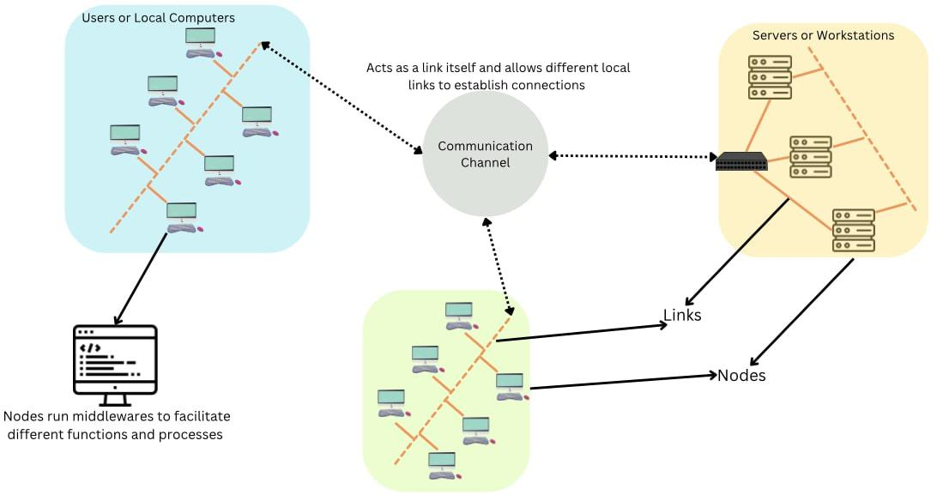

Slide 24
Architectural Model
Architectural model in distributed computing system is the overall design and structure of the system, and how its different components are organised to interact with each other and provide the desired functionalities. It is an overview of the system, on how will the development, deployment and operations take place. Construction of a good architectural model is required for efficient cost usage, and highly improved scalability of the applications. The key aspects of architectural model are –
Client-Server model – It is a centralised approach in which the clients initiate requests for services and severs respond by providing those services. It mainly works on the request-response model where the client sends a request to the server and the server processes it, and responds to the client accordingly. It can be achieved by using TCP/IP, HTTP protocols on the transport layer. This is mainly used in web services, cloud computing, database management systems etc.

Slide 25
4.4 SYSTEM ARCHITECTURES
Client-Server
Peer-to-Peer
Services provided by multiple servers
Proxy servers and caches
Mobile code and mobile agents
Network computers
Thin clients and mobile devices

Slide 26
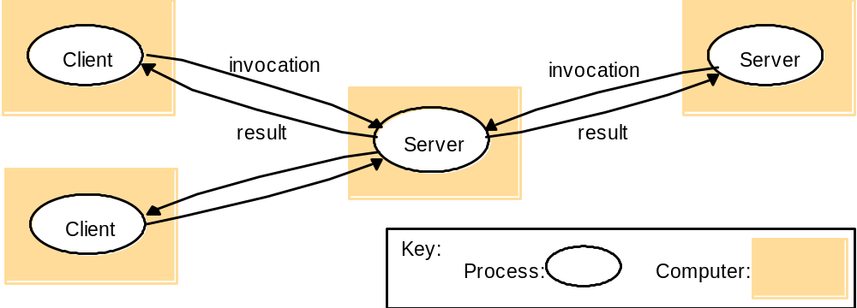
4.4.1 Clients Invoke Individual Servers

Slide 27
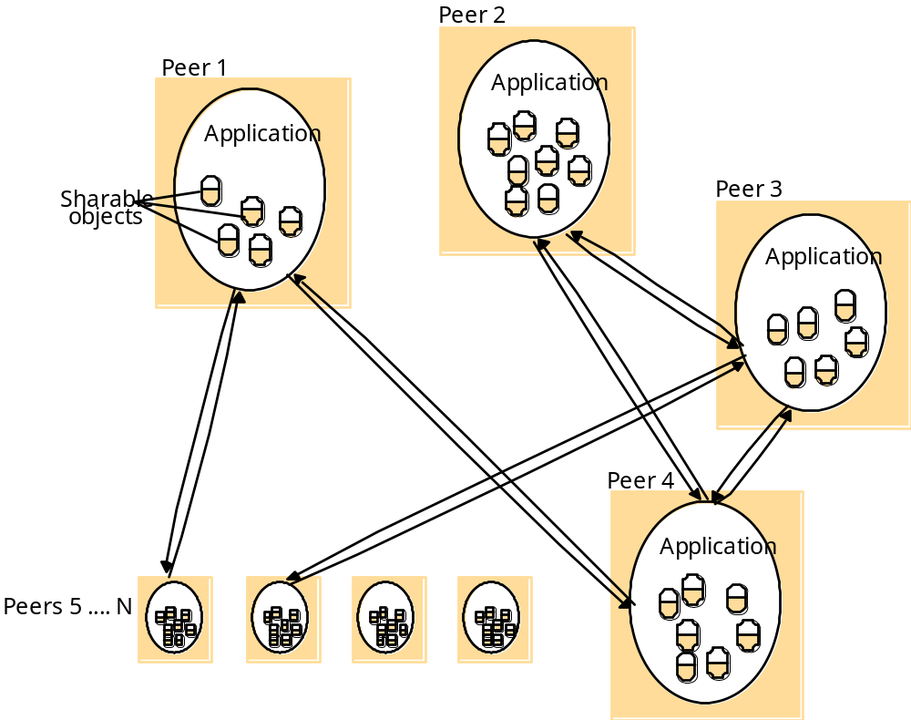
4.4.2 Peer-to-peer Systems

Slide 28
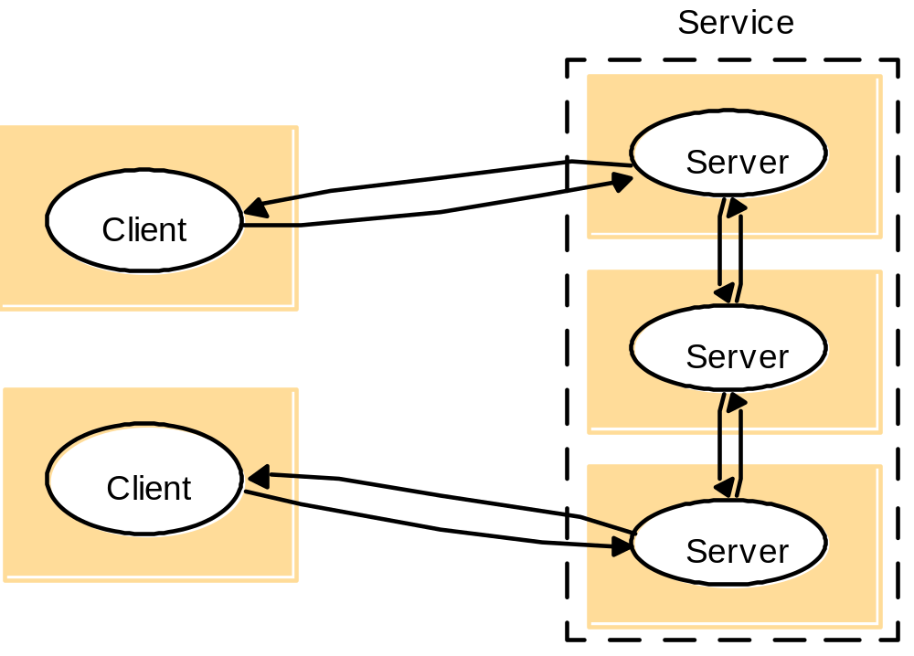
4.4.3 A Service by Multiple Servers
Notes:
Load sharing
Redundancy

Slide 29
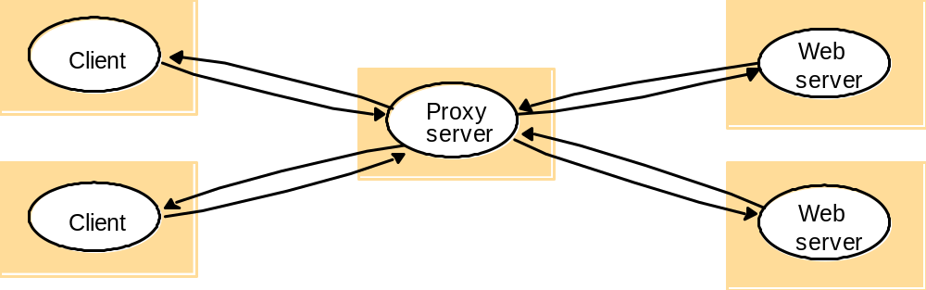
4.4.4 Web Proxy Server

Slide 30
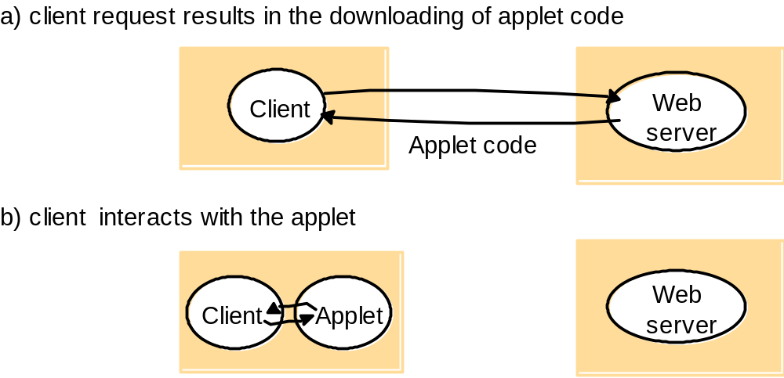
4.4.5 Web Applets

Slide 31
4.4.6 Thin Clients and Compute Servers
Compute server
Network computer or PC
Thin
network
Application
Client
Process

Slide 32
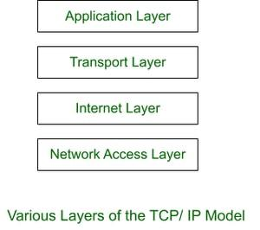
Layered model – It involves organising the system into multiple layers, where each layer will provision a specific service. Each layer communicated with the adjacent layers using certain well-defined protocols without affecting the integrity of the system. A hierarchical structure is obtained where each layer abstracts the underlying complexity of lower layers.

Slide 33
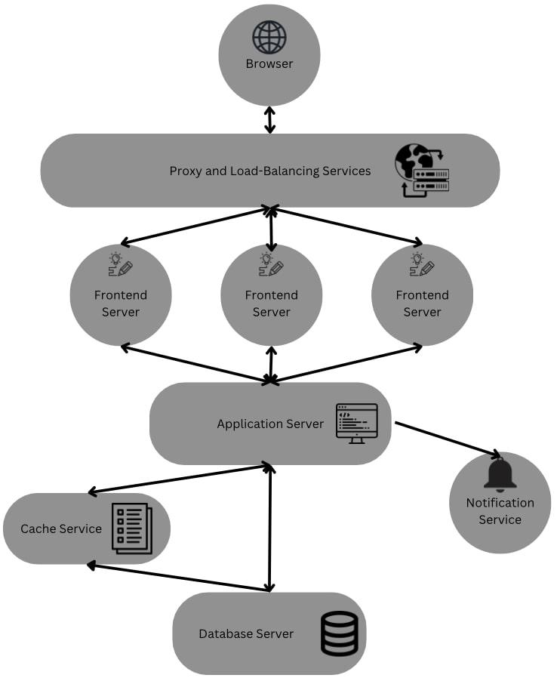
Micro-services model – In this system, a complex application or task, is decomposed into multiple independent tasks and these services running on different servers. Each service performs only a single function and is focussed on a specific business-capability. This makes the overall system more maintainable, scalable and easier to understand. Services can be independently developed, deployed and scaled without affecting the ongoing services.

Slide 34
Fundamental Model
The fundamental model in a distributed computing system is a broad conceptual framework that helps in understanding the key aspects of the distributed systems. These are concerned with more formal description of properties that are generally common in all architectural models. It represents the essential components that are required to understand a distributed system’s behaviour. Three fundamental models are as follows:
Interaction Model – Distributed computing systems are full of many processes interacting with each other in highly complex ways. Interaction model provides a framework to understand the mechanisms and patterns that are used for communication and coordination among various processes. Different components that are important in this model are –
  Message Passing – It deals with passing messages that may contain, data, instructions, a service request, or process synchronisation between different computing nodes. It may be synchronous or asynchronous depending on the types of tasks and processes.
  Publish/Subscribe Systems – Also known as pub/sub system. In this the publishing process can publish a message over a topic and the processes that are subscribed to that topic can take it up and execute the process for themselves. It is more important in an event-driven architecture.

Slide 35
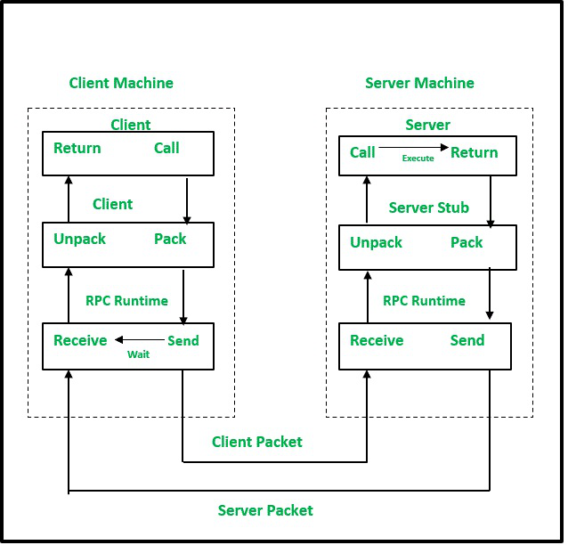
Remote Procedure Call (RPC) – It is a communication paradigm that has an ability to invoke a new process or a method on a remote process as if it were a local procedure call. The client process makes a procedure call using RPC and then the message is passed to the required server process using communication protocols. These message passing protocols are abstracted and the result once obtained from the server process, is sent back to the client process to continue execution.

Slide 36
Failure Model – This model addresses the faults and failures that occur in the distributed computing system. It provides a framework to identify and rectify the faults that occur or may occur in the system. Fault tolerance mechanisms are implemented so as to handle failures by replication and error detection and recovery methods. Different failures that may occur are:
  Crash failures – A process or node unexpectedly stops functioning.
  Omission failures – It involves a loss of message, resulting in absence of required communication.
  Timing failures – The process deviates from its expected time quantum and may lead to delays or unsynchronised response times.
  Byzantine failures – The process may send malicious or unexpected messages that conflict with the set protocols.
Security Model – Distributed computing systems may suffer malicious attacks, unauthorised access and data breaches. Security model provides a framework for understanding the security requirements, threats, vulnerabilities, and mechanisms to safeguard the system and its resources. Various aspects that are vital in the security model are – Authentication – It verifies the identity of the users accessing the system. It ensures that only the authorised and trusted entities get access. It involves –
  Password-based authentication – Users provide a unique password to prove their identity.
  Public-key cryptography – Entities possess a private key and a corresponding public key, allowing verification of their authenticity.
  Multi-factor authentication – Multiple factors, such as passwords, biometrics, or security tokens, are used to validate identity.
Encryption – It is the process of transforming data into a format that is unreadable without a decryption key. It protects sensitive information from unauthorized access or disclosure.

Slide 37
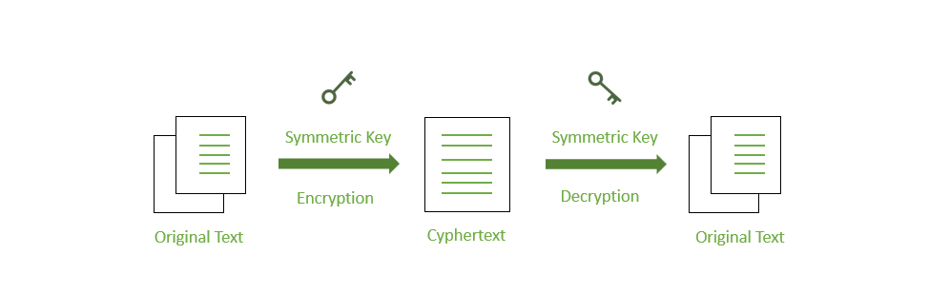
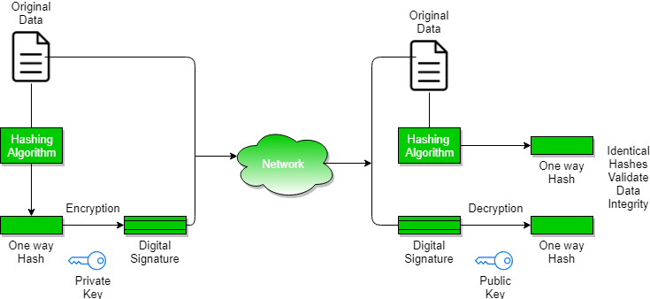
Data Integrity – Data integrity mechanisms protect against unauthorised modifications or tampering of data. They ensure that data remains unchanged during storage, transmission, or processing. Data integrity mechanisms include:
  Hash functions – Generating a hash value or checksum from data to verify its integrity.
  Digital signatures – Using cryptographic techniques to sign data and verify its authenticity and integrity.

Slide 38
Distributed Computing System Models
Distributed computing refers to a system where processing and data storage is distributed across multiple devices or systems, rather than being handled by a single central device.
Types of Distributed Computing System Models
Physical Model
Architectural Model
Fundamental Model
Physical Model
A physical model is basically a representation of the underlying hardware elements of a distributed system. It encompasses the hardware composition of a distributed system in terms of computers and other devices and their interconnections. It is primarily used to design, manage, implement and determine the performance of a distributed system. A physical model majorly consists of the following components:

